Slide 1
Big Data Processing
Jiaul Paik
IIT Kharagpur
Lecture 6

Slide 2
Map-Reduce in Search Engines

Slide 3
Objectives
Modern search engines deal with huge volume of data
No single machine can manage it
Need to do things fast
MR is a very good fit
Scalable MR algorithm with value-to-key design pattern
Why and how to use custom partitioner

Slide 4
Typical Search Engine Architecture
Documents
Query
online
offline
Representation
Function
Representation
Function
Query Representation
Document Representation
Retrieval
online job
Index
Comparison
Function
MR: No
Indexing
Hits
offline job
MR: Yes
Source: Jimmy Lin

Slide 5
Creating Index
Doc 1
Doc 2
Doc 3
Doc 4
one fish, two fish
red fish, blue fish
cat in the hat
green eggs and ham
1
2
3
4
What goes in each cell?
blue
1
cat
1
boolean
count
egg
1
positions
fish
1
1
green
1
ham
1
hat
1
one
1
red
1
two
1

Slide 6
Creating Index
Doc 1
Doc 2
Doc 3
Doc 4
one fish, two fish
red fish, blue fish
cat in the hat
green eggs and ham
1
2
3
4
blue
1
Indexing: building this structure
cat
1
egg
1
Retrieval: manipulating this structure
fish
1
1
green
1
ham
1
hat
1
one
1
red
1
two
1

Slide 7
Creating Index
Doc 1
Doc 2
Doc 3
Doc 4
one fish, two fish
red fish, blue fish
cat in the hat
green eggs and ham
1
2
3
4
blue
1
blue
2
cat
1
cat
3
egg
1
egg
4
fish
1
1
fish
1
2
green
1
green
4
ham
1
ham
4
hat
1
hat
3
one
1
one
1
red
1
red
2
two
1
two
1
postings lists
(always in sorted order)

Slide 8
Creating Index
Doc 1
Doc 2
Doc 3
Doc 4
one fish, two fish
red fish, blue fish
cat in the hat
green eggs and ham
tf
1
2
3
4
df
blue
1
1
blue
1
2
1
cat
1
1
cat
1
3
1
egg
1
1
egg
1
4
1
fish
2
2
2
fish
2
1
2
2
2
green
1
1
green
1
4
1
ham
1
1
ham
1
4
1
hat
1
1
hat
1
3
1
one
1
1
one
1
1
1
red
1
1
red
1
2
1
two
1
1
two
1
1
1

Slide 9
Creating Index
Doc 1
Doc 2
Doc 3
Doc 4
one fish, two fish
red fish, blue fish
cat in the hat
green eggs and ham
tf
1
2
3
4
df
blue
1
1
blue
1
2
1
[3]
cat
1
1
cat
1
3
1
[1]
egg
1
1
egg
1
4
1
[2]
fish
2
2
2
fish
2
1
2
[2,4]
2
2
[2,4]
green
1
1
green
1
4
1
[1]
ham
1
1
ham
1
4
1
[3]
hat
1
1
hat
1
3
1
[2]
one
1
1
one
1
1
1
[1]
red
1
1
red
1
2
1
[1]
two
1
1
two
1
1
1
[3]

Slide 10
MapReduce: Index Construction
Map over all documents
Emit term as key, (docid, tf) as value
Emit other information as necessary (e.g., term position)
Sort/shuffle: group postings by term
Reduce
Gather and sort the postings (typically by docid)
Write postings to disk

Slide 11
Inverted Indexing with MapReduce: First Cut
Doc 1
Doc 2
Doc 3
one fish, two fish
red fish, blue fish
cat in the hat
one
1
1
red
2
1
cat
3
1
Map
two
blue
hat
1
1
2
1
3
1
fish
1
2
fish
2
2
Shuffle and Sort: aggregate values by keys
cat
3
1
Reduce
blue
2
1
fish
1
2
2
2
hat
3
1
one
1
1
two
1
1
red
2
1

Slide 12
Inverted Indexing: Pseudo-Code
class Mapper {
map(docid, doc) = {
counts = new HashMap()
for (term in tokenize(doc)) {
counts(term) += 1
}
for ((term, tf) in counts) {
emit(term, (docid, tf))
}
}
}
class Reducer {
reduce(term, postings: list[(docid, tf)]) = {
p = new List()
for ((docid, tf) in postings) {
p.append((docid, tf))
}
p.sort()
emit(term, p)
}
}

Slide 13
Positional Indexes
Doc 1
Doc 2
Doc 3
one fish, two fish
red fish, blue fish
cat in the hat
one
1
1
[1]
red
2
1
[1]
cat
3
1
[1]
Map
two
blue
hat
1
1
[3]
2
1
[3]
3
1
[2]
fish
1
2
[2,4]
fish
2
2
[2,4]
Shuffle and Sort: aggregate values by keys
cat
3
1
[1]
Reduce
blue
2
1
[3]
fish
1
2
[2,4]
2
2
[2,4]
hat
3
1
[2]
one
1
1
[1]
two
1
1
[3]
red
2
1
[1]

Slide 14
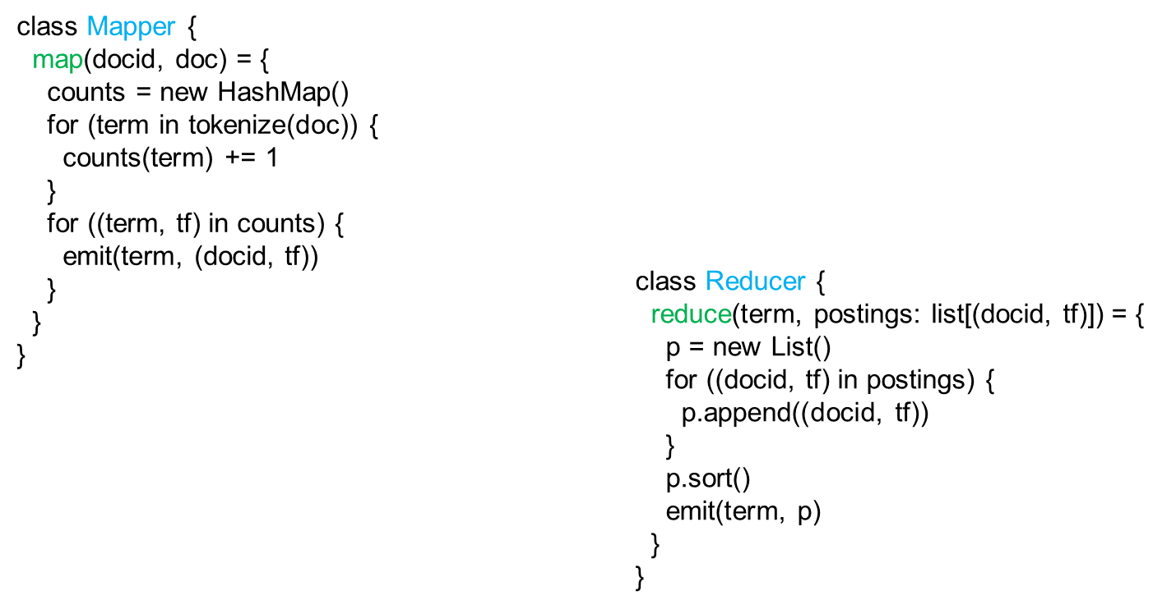
Where is the trouble?

Slide 15
Scalable MR Indexing: Value to Key
(key)
(values)
(keys)
(values)
fish
1
2
fish
1
2
34
1
fish
9
1
21
3
fish
21
3
35
2
fish
34
2
80
3
fish
35
3
9
1
fish
80
1
Let the MR framework do the sorting!

Slide 16
Inverted Indexing: Pseudo-Code
class Mapper {
map(docid, doc) = {
counts = new HashMap()
for (term in tokenize(doc)) {
counts(term) += 1
}
for ((term, tf) in counts) {
emit((term, docid), tf)
}
}
}
class Reducer {
prev = null
postings = new PostingsList()
reduce(key, tf) = {
if (key.term != prev & prev != null) {
emit(prev, postings)
postings.reset()
}
postings.append(key.docid, tf)
prev = key.term
}
}

Slide 17
Another Hiccup
By default, MR does not ensure data for the same word will come to the same reducer
You need to define your own partition function

Slide 18
Map-reduce System: Inside Look
map task 1
map task 2
map task 3
data | data | data
data | data | data
data | data | data
M
M
M
M
M
M
M
M
M
($k_{1}, v_{1}$) ($k_{2}, v_{2}$) | ($k_{3}, v_{4}$) | ($k_{4}, v_{4}$)
($k_{2}, v_{1}$) | ($k_{1}, v_{4}$) ($k_{2}, v_{2}$) | ($k_{3}, v_{5}$)
($k_{2}, v_{6}$) | ($k_{3}, v_{7}$) | ($k_{1}, v_{5}$)
partition function
partition function
partition function
SORT and GROUP
$$k_{1}:{ v}_{1},v_{4},v_{5}$$ | $$k_{4}:v_{4}$$
SORT and GROUP
$$k_{2}:v_{2},v_{1},v_{2},v_{6}$$ | $$k_{3}:v_{4},v_{5},v_{7}$$
R
R
R
R
Final output | Final output
Final output | Final output
reduce task 1
reduce task 2

Slide 19
Custom Partitioner

